Slide 1
Complex Integration (Line Integral) Exercise:6 (Part-1)

Slide 2
Objective:
Finding the path of integration in different form
Methodologies:
By separating real and imaginary part equation of the path will be evaluated.

Slide 3
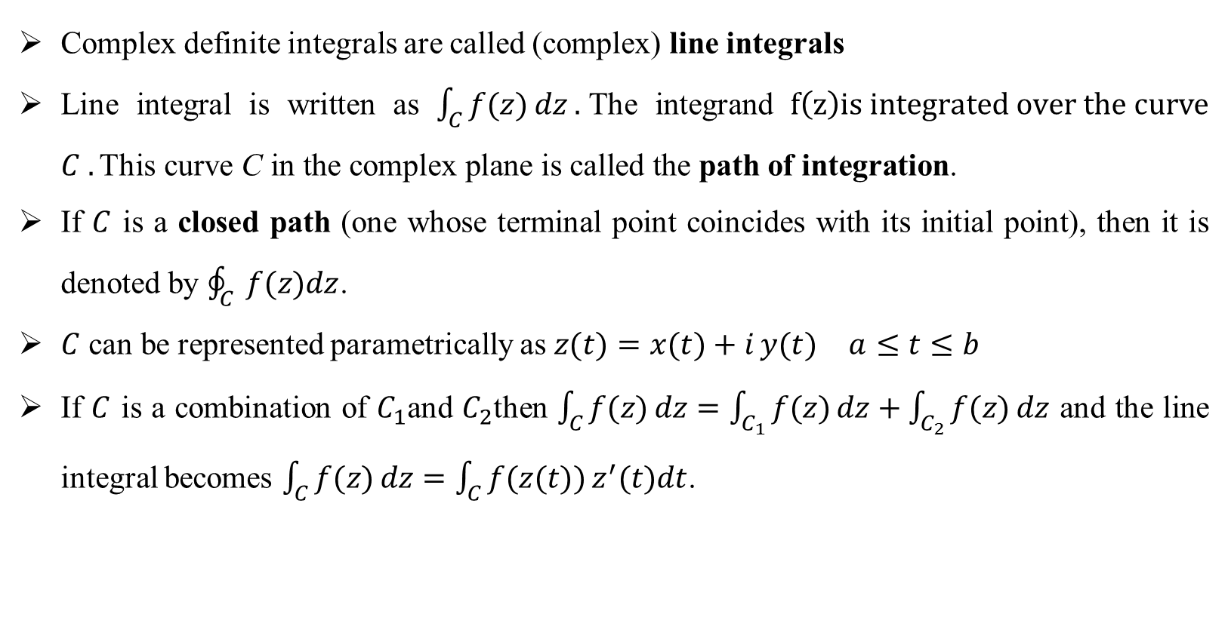
Line Integral:
Complex definite integrals are called (complex) line integrals
Line integral is written as $\int_{C}{f(z) dz}.$The integrand $f\left(z\right)is integrated over the curve$ $C .\text{This} \text{curve} \text{C} \text{in} \text{the} \text{complex} \text{plane} \text{is} \text{called} \text{the} \text{path} \text{of} \text{integration}\text{.}$
If $C$ is a closed path (one whose terminal point coincides with its initial point), then it is denoted by $\oint_{C}{ f(z)dz}$.
$C$ can be represented parametrically as $z(t)=x(t)+i y(t) a≤t≤b$
If $C$ is a combination of $C_{1}$and $C_{2}$then $\int_{C}{f(z) dz}=\int_{C_{1}}{f(z) dz}+\int_{C_{2}}{f(z) dz}$ and the line integral becomes $\int_{C}{f(z) dz}=\int_{C}{f(z(t)) z^{′}(t)dt}$.

Slide 4

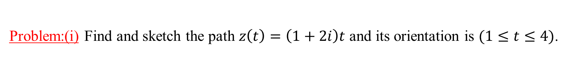


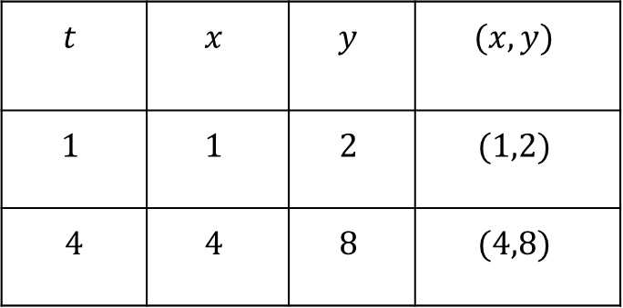
Problem:(i) Find and sketch the path $z\left(t\right)=\left(1+2i\right)t$ and its orientation is $(1≤t≤4)$.
Solution: $z\left(t\right)=\left(1+2i\right)t \left(1≤t≤4\right)$
$⇒x\left(t\right)+i y\left(t\right)=t+i 2t$
Comparing real and imaginary part, we get
$x\left(t\right)=t$ , $y\left(t\right)=2t$ $(1≤t≤4)$.
Im {z}
$$(4,8)$$
$$t$$ | $$x$$ | $$y$$ | $$(x,y)$$
$$1$$ | $$1$$ | $$2$$ | $$(1,2)$$
$$4$$ | $$4$$ | $$8$$ | $$(4,8)$$
$$(1,2)$$
Re {z}
O

Slide 5
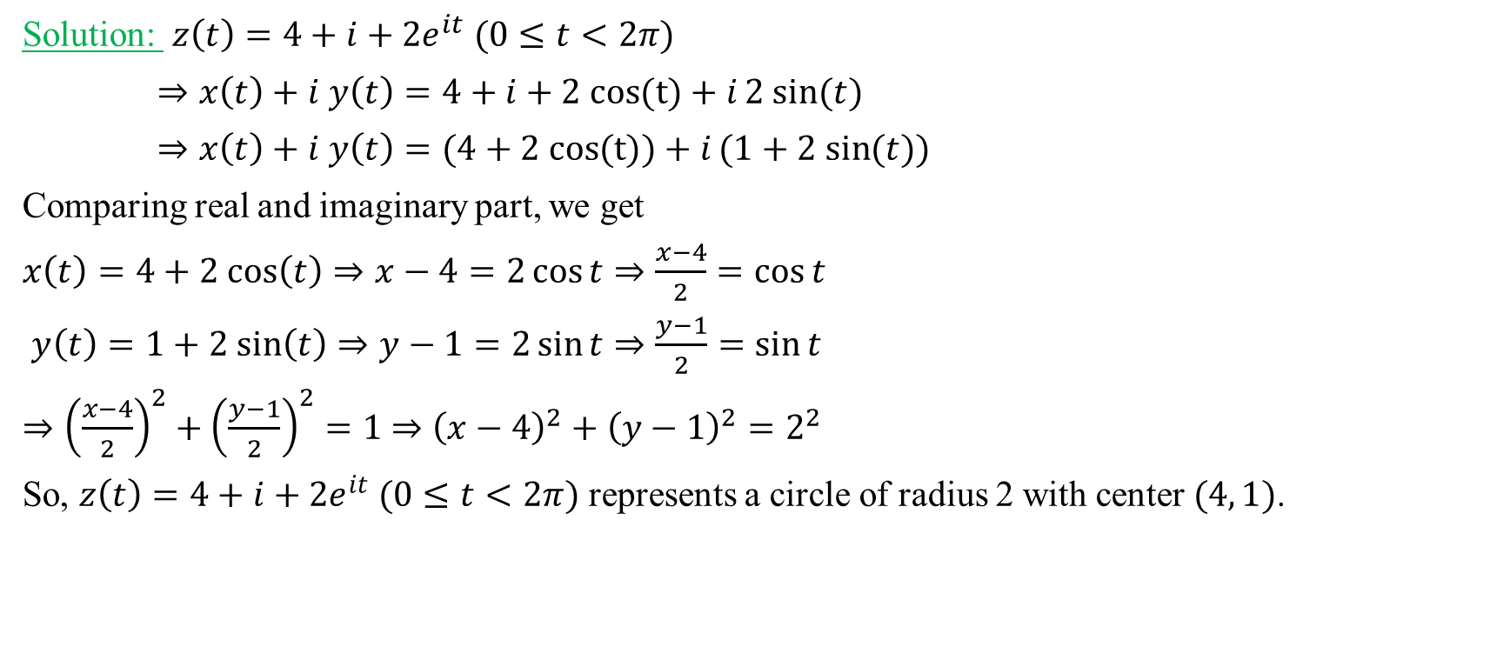



Problem: (ii) Find and sketch the path $z\left(t\right)={4+i+2e}^{it}$and its orientation$\left(0≤t≤2π\right)$.
Im {z}
Solution: $z\left(t\right)={4+i+2e}^{it} (0≤t<2π)$
$⇒x\left(t\right)+i y\left(t\right)=4+i+2 cos{(t)}+i2 sin{(t)}$
$⇒x\left(t\right)+i y\left(t\right)=(4+2 cos{(t))}+i(1+2 sin{(t))}$
Comparing real and imaginary part, we get
$x\left(t\right)=4+2 cos\left(t\right)⇒x−4=2\cos{t⇒\frac{x−4}{2}=\cos{t}}$
$y\left(t\right)=1+2 sin\left(t\right)⇒y−1=2\sin{t⇒\frac{y−1}{2}=\sin{t}}$
$⇒{\left(\frac{x−4}{2}\right)}^{2}+{\left(\frac{y−1}{2}\right)}^{2}=1$ $⇒{\left(x−4\right)}^{2}+{\left(y−1\right)}^{2}=2^{2}$
So, $z\left(t\right)={4+i+2e}^{it} (0≤t<2π)$ represents a circle of radius 2 with center $(4, 1)$.
$$(4,1)$$
O
$$2$$
Re {z}

Slide 6
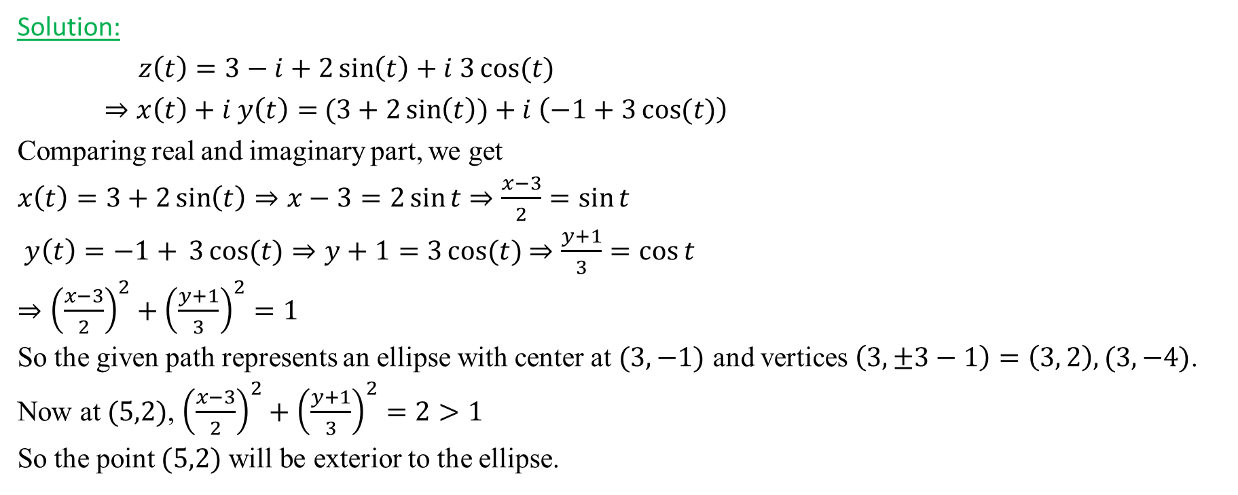
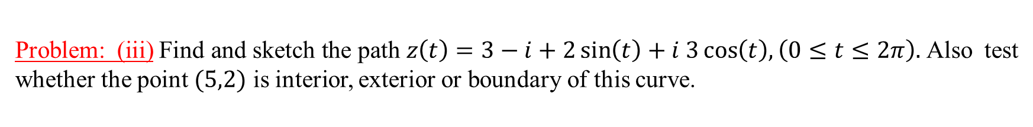


Problem: (iii)$\text{Find} \text{and} \text{sketch} \text{the} \text{path} z\left(t\right)=3−i+2\sin\left(t\right)+i 3\cos\left(t\right),\left(0≤t≤2π\right).$Also test whether the point $(5,2)$ is interior, exterior or boundary of this curve.
Solution:
$z\left(t\right)=3−i+2\sin\left(t\right)+i 3\cos{(t)}$
$⇒x\left(t\right)+i y\left(t\right)=$ $(3+2\sin\left(t\right))+i \left(−1+3\cos{(t)}\right)$
Comparing real and imaginary part, we get
$x\left(t\right)=3+2\sin\left(t\right)⇒x−3=2\sin{t}$ $⇒\frac{x−3}{2}=\sin{t}$
$y\left(t\right)=−1+{3\cos{(t)}⇒y+1=3\cos{(t)}}$ $⇒\frac{y+1}{3}=\cos{t}$
$⇒{\left(\frac{x−3}{2}\right)}^{2}+{\left(\frac{y+1}{3}\right)}^{2}=1$
So the given path represents an ellipse with center at $(3,−1)$ and vertices $\left(3,±3−1\right)=$ $\left(3, 2\right), (3, −4)$.
Now at $(5,2)$, ${\left(\frac{x−3}{2}\right)}^{2}+{\left(\frac{y+1}{3}\right)}^{2}=2>1$
So the point $(5,2)$ will be exterior to the ellipse.
Im {z}
$$(5,2)$$
O
Re {z}
$$(3,−1)$$

Slide 7

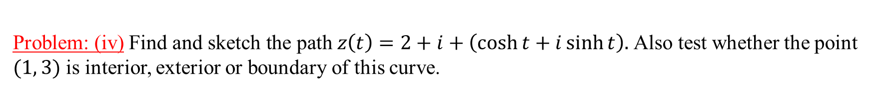


Problem: (iv)$\text{Find} \text{and} \text{sketch} \text{the} \text{path} z\left(t\right)=2+i+\left(\cosh{t+i\sinh{t}}\right).$Also test whether the point $(1, 3)$ is interior, exterior or boundary of this curve.
Solution:
$z\left(t\right)=2+i+\left(\cosh{t+i\sinh{t}}\right)$
$⇒x\left(t\right)+i y\left(t\right)=2+i+ cosh{t}+i\sinh{t}$
$⇒x\left(t\right)+i y\left(t\right)=(2+cosh{(t))}+i(1+ sinh{(t))}$
Comparing real and imaginary part, we get
$x\left(t\right)=2+cosh{(t)}⇒x−2=\cosh{t}$
$y\left(t\right)=1+ sinh\left(t\right)⇒y−1=\sinh{t}$
$⇒{\left(x−2\right)}^{2}−{\left(y−1\right)}^{2}=1$
So the given path represents a hyperbola with center at $\left(2,1\right)$and vertices $\left(±1+2, 1\right)=\left(3,1\right), (1,1)$.
Now at $(1,3)$, ${\left(x−2\right)}^{2}−{\left(y−1\right)}^{2}=−3<1$
So the point $(1,3)$ will be interior to the hyperbola.
Im {z}
$$(1,3)$$
$$(2,1)$$
O
Re {z}

Slide 8
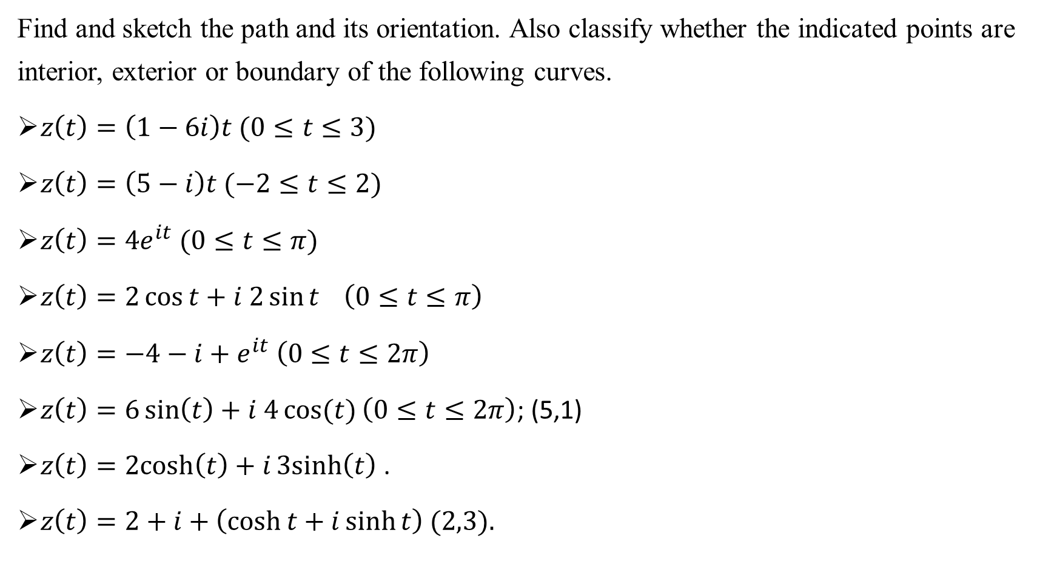
Exercises:
Find and sketch the path and its orientation. Also classify whether the indicated points are interior, exterior or boundary of the following curves.
$z\left(t\right)=\left(1−6i\right)t (0≤t≤3)$
$z\left(t\right)=\left(5−i\right)t (−2≤t≤2)$
$z\left(t\right)={4e}^{it} (0≤t≤π)$
$z\left(t\right)=2\cos{t+i 2\sin{t} \left(0≤t≤π\right)}$
$z\left(t\right)={−4−i+e}^{it} \left(0≤t≤2π\right)$
$z\left(t\right)=6\sin\left(t\right)+i 4\cos{(t)}\left(0≤t≤2π\right)$; (5,1)
$z\left(t\right)=2cosh\left(t\right)+i3sinh\left(t\right)$.
$z\left(t\right)=2+i+\left(\cosh{t+i\sinh{t}}\right) (2,3).$

Slide 9
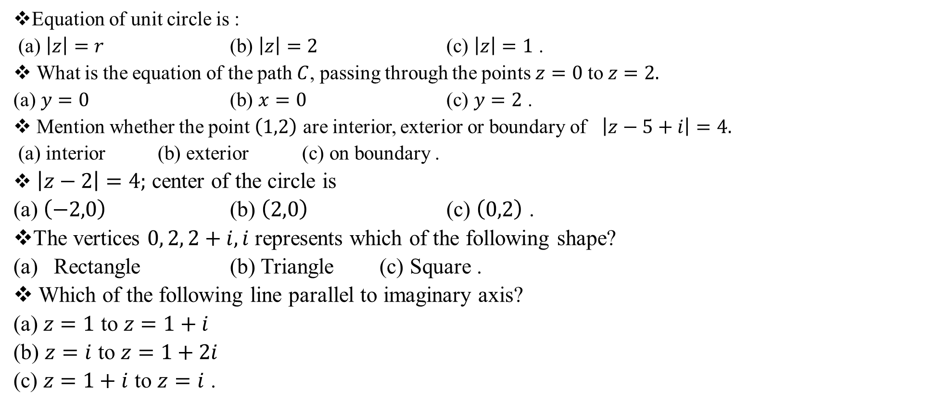
Sample MCQ:
Equation of unit circle is :
(a) $\left|z\right|=r$ (b) $\left|z\right|=2$ (c) $\left|z\right|=1$ .
What is the equation of the path $C$, passing through the points $z=0$ to $z=2.$
(a) $y=0$ (b) $x=0$ (c) $y=2$ .
Mention whether the point $\left(1,2\right)$ are interior, exterior or boundary of $\left|z−5+i\right|=4.$
(a) interior (b) exterior (c) on boundary .
$\left|z−2\right|=4;$ center of the circle is
(a) $\left(−2,0\right)$ (b) $\left(2,0\right)$ (c) $\left(0,2\right)$ .
The vertices $0, 2, 2+i, i$ represents which of the following shape?
Rectangle (b) Triangle (c) Square .
Which of the following line parallel to imaginary axis?
(a) $z=1$ to $z=1+i$
(b) $z=i$ to $z=1+2i$
(c) $z=1+i$ to $z=i$ .

